Slide 1

Mortgage Delinquency
Data Science Certificate Program: Cohort 16

Slide 2
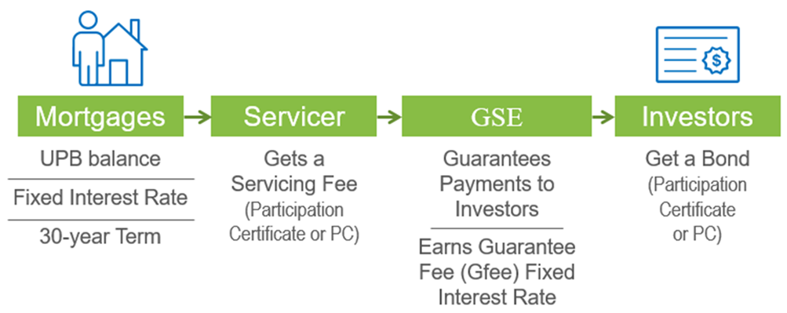
Domain Information
GSE acts as a mortgage credit guarantor – serves as a “facilitator” between originators and dealers;
GSE provides good pipeline management support;
Through PC, Default loans were guaranteed to be paid by Fannie or Freddie;

Slide 3
Hypothesis
TEAM Goal: To take key performance indicators and create a predicative model based on origination data that will allow a prediction of the default or delinquency rate of a mortgage within a 60-80% accuracy.
Project Description:
Mortgage Delinquency/Default rate using key performance indicators (KPI) to build a data frame model which will be used for predictive analytics to determine delinquency/default of the mortgage along with current state of the economy.
Utilizing statistical trend and regression analysis and methodologies to test the model. Utilizing test data to test the model to accurately forecast the probability that a mortgage with become delinquent/default.
Present the results of the model indicating the accuracy of the model and the visualization of results.

Slide 4
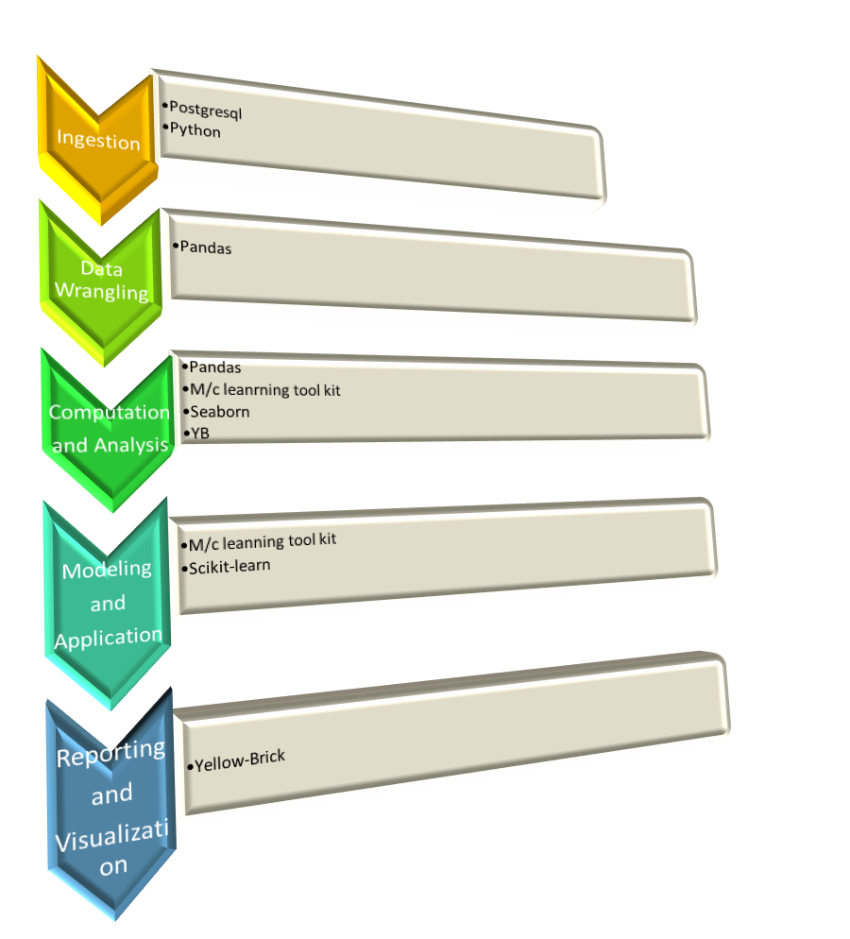
Pipeline Architecture

Slide 5

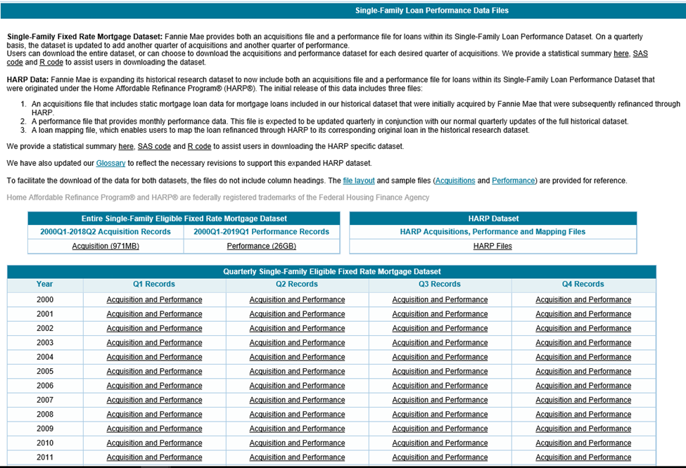
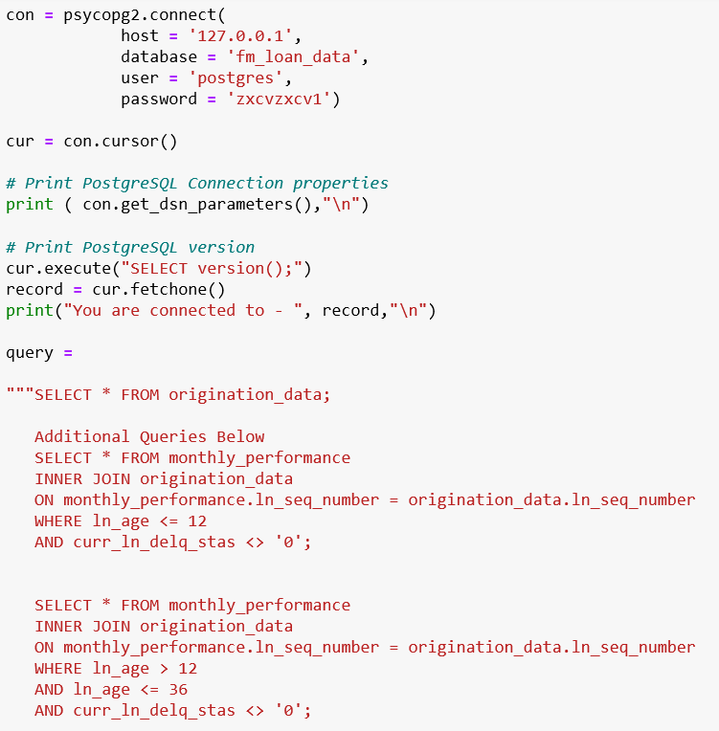
Ingestion

Slide 6
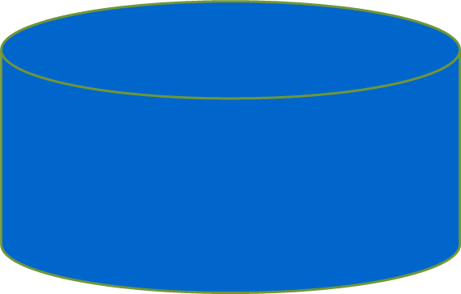
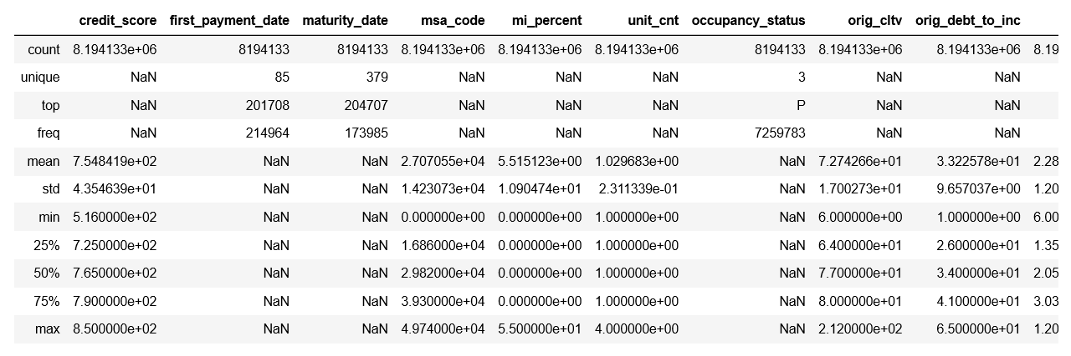
Data Wrangling

Slide 7
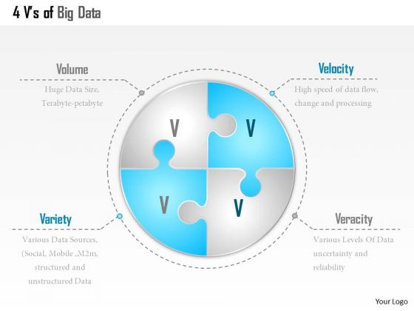

Slide 8
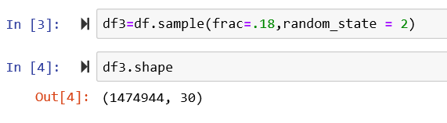
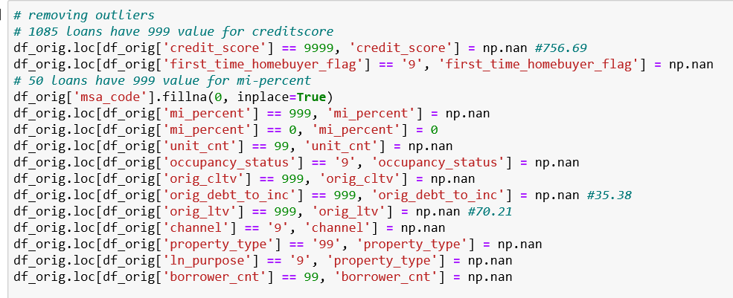
Actions done:
Notebook: Code Examples

Slide 9

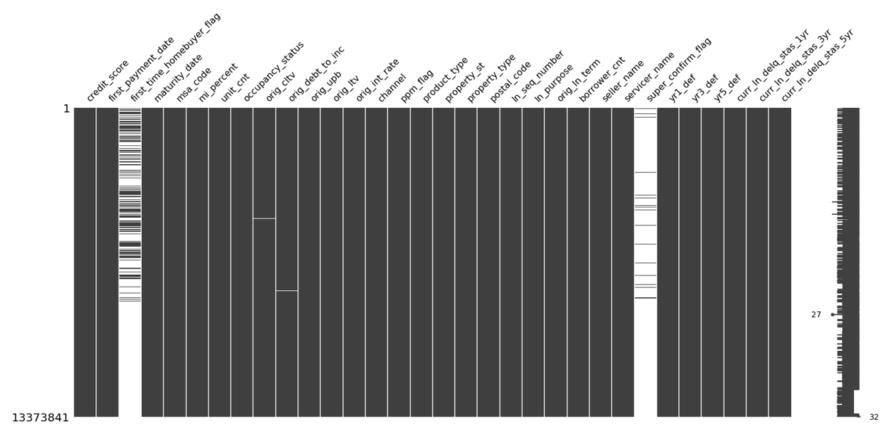
Locating the NANs using a NAN Matrix within the dataset

Slide 10
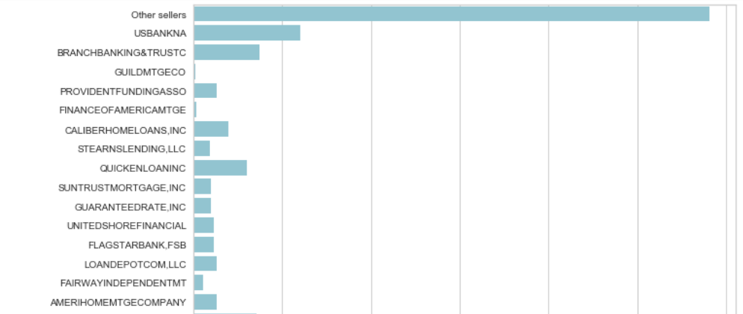
List of Sellers: Freddie Mac purchases loans

Slide 11
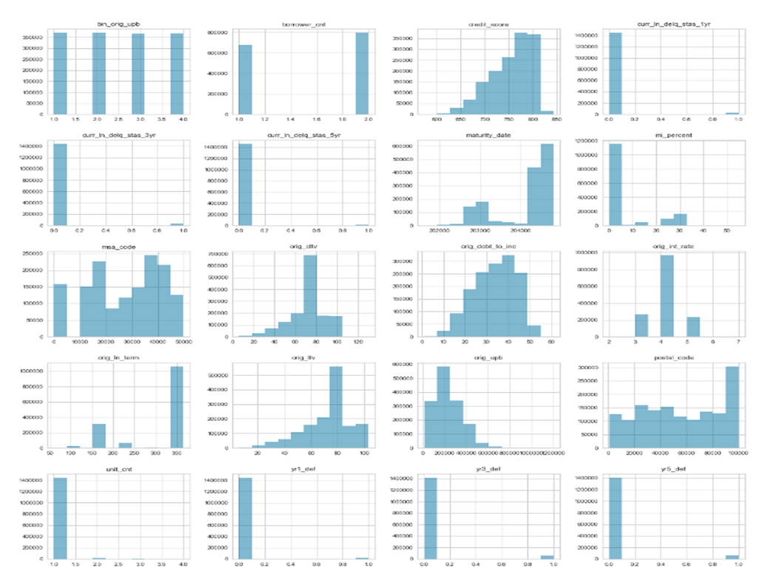
Histogram Exploration of Numeric Data Features

Slide 12
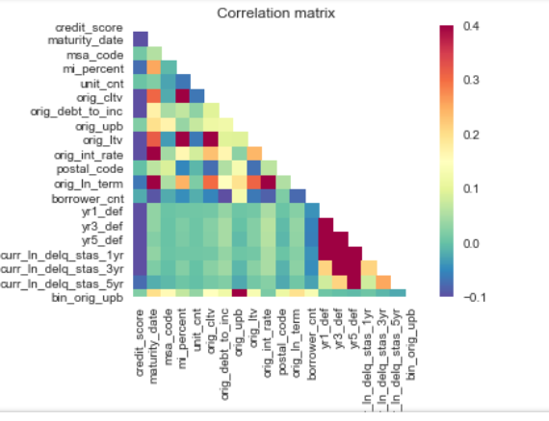
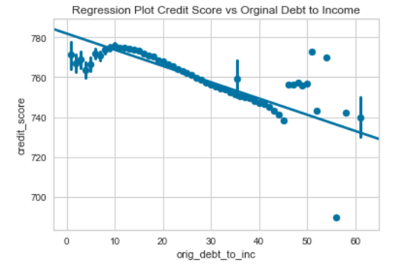

Slide 13
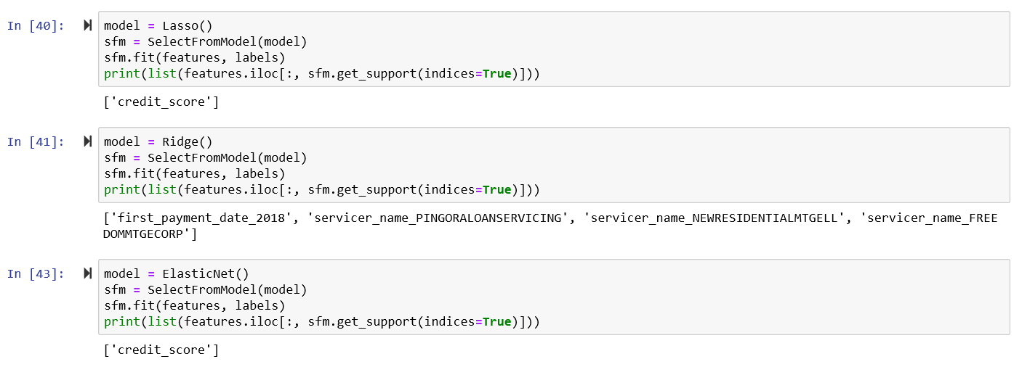
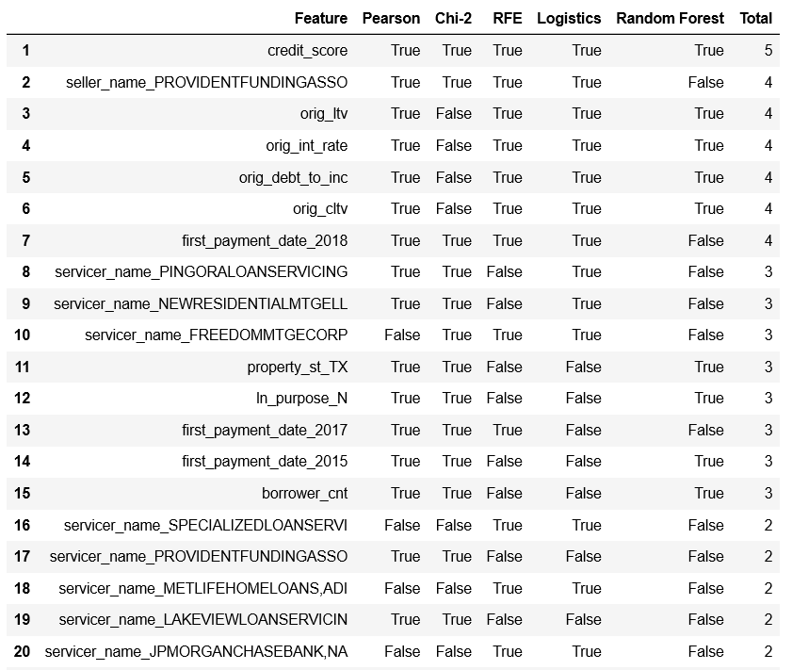
Breakdown of pipeline on slides
Feature Analysis
Scikit-Learn has a meta-transformer method for selecting features based on importance weights.

Slide 14
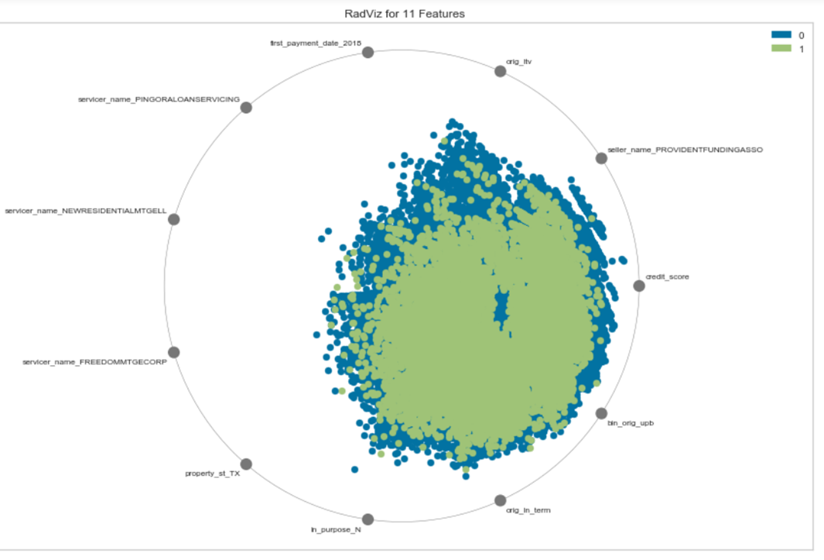

Slide 15
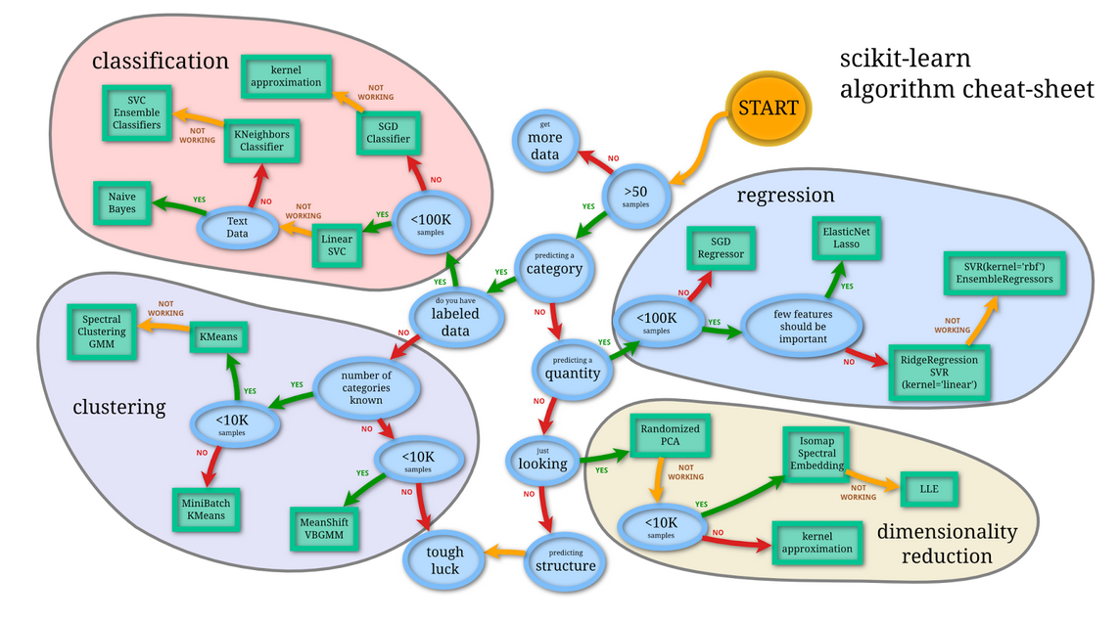

Slide 16
Breakdown of pipeline on slides
Modeling And Application
Based on the results of running classification models we found that Bagging Classifier was the most accurate model
Model | Loan Classification | Precision | Recall | FI Score
SVC | Bad Loan | 0.00 | 0.00 | 0.00
SVC | Good Loan | 0.96 | 1.00 | 0.98
Linear SVC | Bad Loan | 0.86 | 0.00 | 0.00
Linear SVC | Good Loan | 0.96 | 1.00 | 0.98
SGD Classifier | Bad Loan | 0.00 | 0.00 | 0.00
SGD Classifier | Good Loan | 0.96 | 1.00 | 0.98
K Neighbors Classifier | Bad Loan | 0.57 | 0.01 | 0.02
K Neighbors Classifier | Good Loan | 0.96 | 1.00 | 0.98
Logistic Regression | Bad Loan | 0.38 | 0.00 | 0.00
Logistic Regression | Good Loan | 0.96 | 1.00 | 0.98
Logistic Regression CV | Bad Loan | 0.00 | 0.00 | 0.00
Logistic Regression CV | Good Loan | 0.96 | 1.00 | 0.98
Bagging Classifier | Bad Loan | 0.99 | 0.73 | 0.85
Bagging Classifier | Good Loan | 0.98 | 1.00 | 1.00
Extra Trees Classifier | Bad Loan | 1.00 | 1.00 | 1.00
Extra Trees Classifier | Good Loan | 1.00 | 1.00 | 1.00
Random Forest Classifier | Bad Loan | 1.00 | 0.98 | 0.99
Random Forest Classifier | Good Loan | 1.00 | 1.00 | 1.00

Slide 17
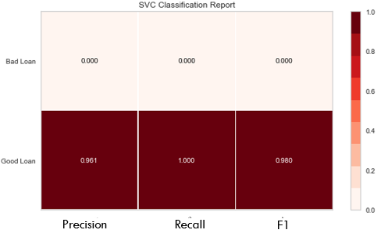
Result Visualizations
Reporting And Visualization
Precision: The count of correct positive results divided by the number of all positive results
Recall: The count of the correct positive results divided by the number of positive results that should have been returned.
F1: Score: Accuracy score of the model
Recall and the F1 score are the most import aspects of the classification report results.
A low F1 score will indicate that the overall model is not accurate, however a high Recall will indicate the model did identify a bad loan

Slide 18
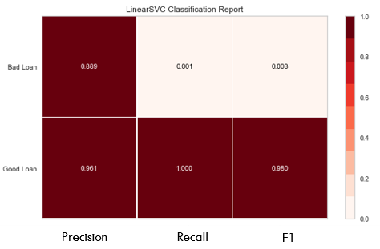
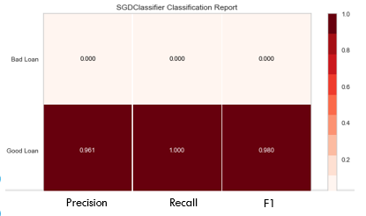
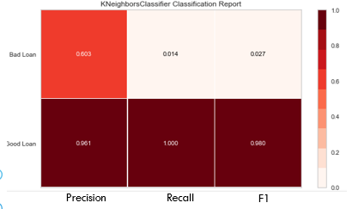
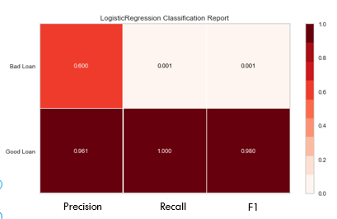

Slide 19
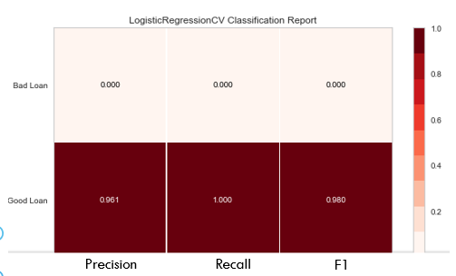
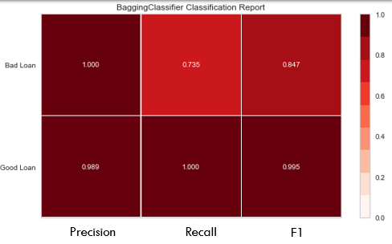
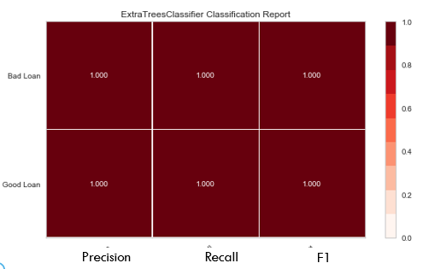
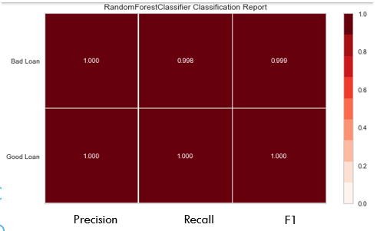

Slide 20
Conclusion
The hypotheses was to create a model with 60%-80% accuracy
The Bagging Classifier Model supported the hypotheses with a model accuracy score of 84.7%
The Bagging Classifier Model recalled bad loans 73.5% of the time
The Bagging Classifier Model was not overfit as other model accuracy scores indicated.
Do to the volume of the data and other various contingencies the model would need more development before any business application.

Slide 21
Further Exploration
The performance data of the mortgages is captured on a monthly basis. This can be reviewed as a multivariate time-series. For future exploration time-series models should be explored to determine trends within the data features of the monthly performance data. Some of the models/testing options to investigate would be Dickey-Fuller, and ARIMA (Autoregressive Integrated Moving Average).
Other option would be to change the target from delinquency status to the income to debt ratio from the origination dataset. This change could show different indicators related to the what affect the debt to income has on the probability of a mortgage having an instance of delinquency within the performance of the loan.

